Slide 1
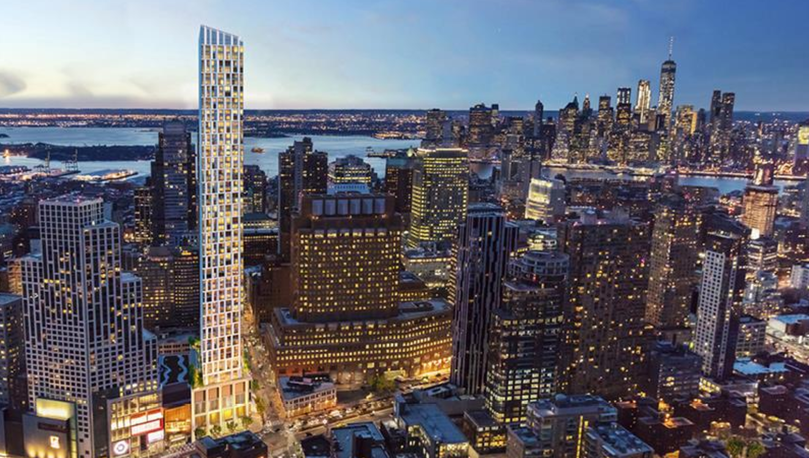
Real Estate Investment in Brooklyn
Which neighborhoods have the highest potential to grow?

Slide 2
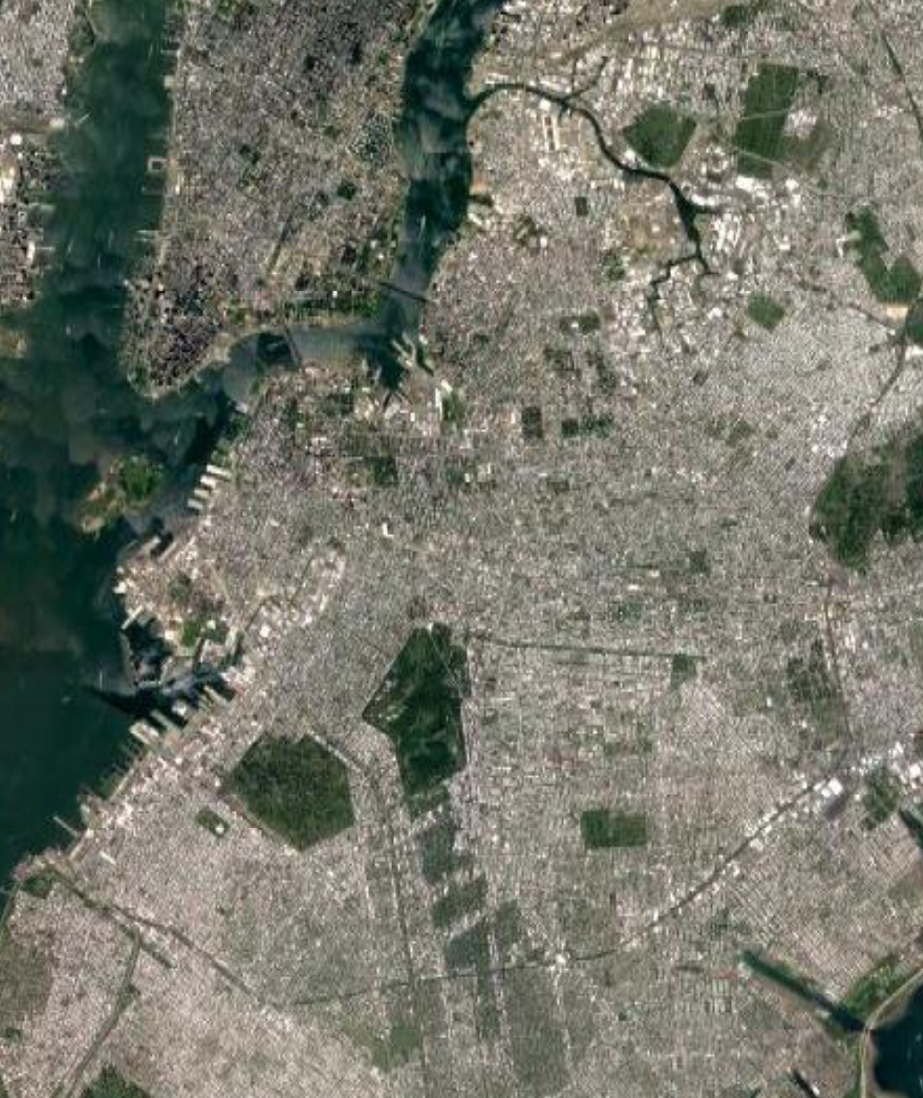
The Problem:
In order to invest in properties with the highest return on investment, a real estate developer is exploring neighborhoods in Brooklyn, NY to predict which neighborhoods are more promising in their future growth. They believe that neighborhoods with best opportunities are the ones that share similar charactersitics in terms of trending venues with the ones that have already had a fast growth. The neighborhoods that have already grown in the past few years are as following:
Dumbo
Downtown Brookly
Fort Greene
The Solution:
To find this similarity, my method would be to cluster all neighborhoods in Brooklyn and find which neighborhoods will be in the same cluster as the three above neighborhoods selected by the real estate team as the models.
1
2
3

Slide 3
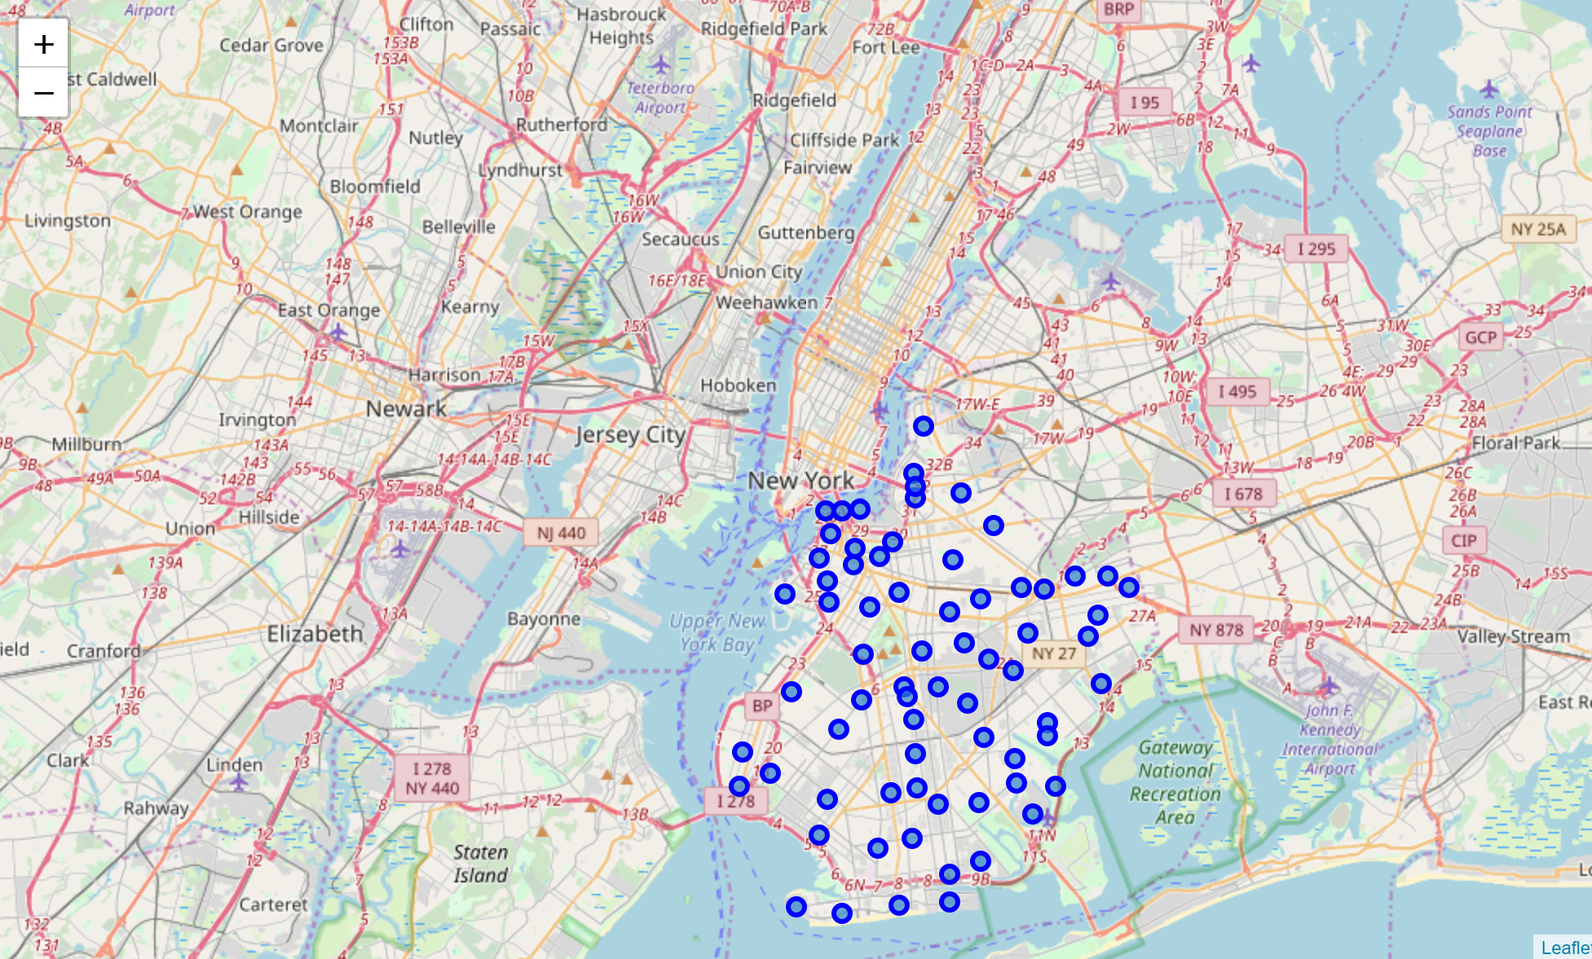
Number of neighborhoods in Brooklyn:
70

Slide 4
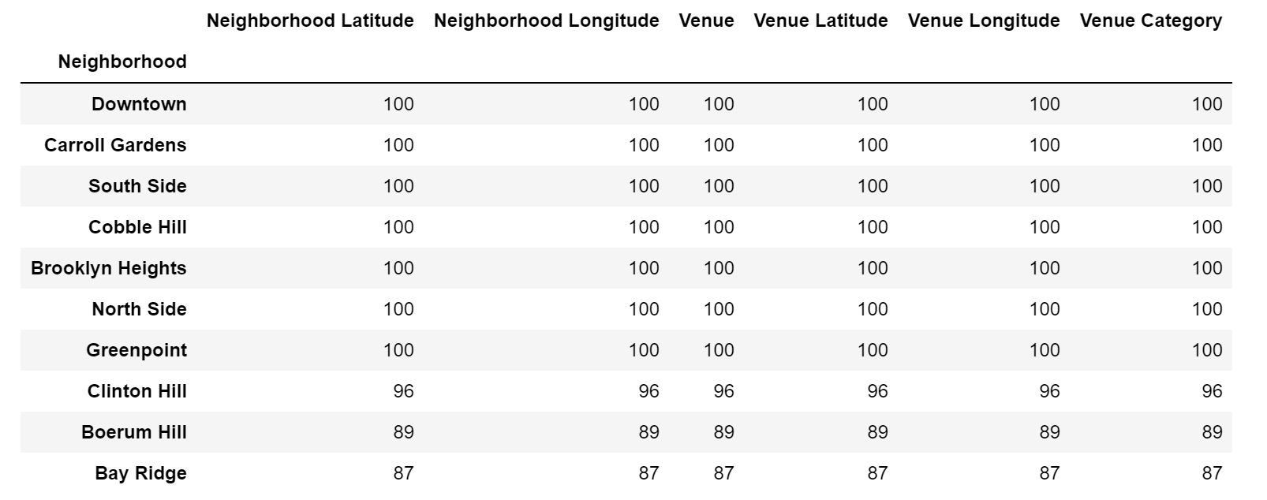
Top 10 Neighborhoods by Number of Venues:

Slide 5
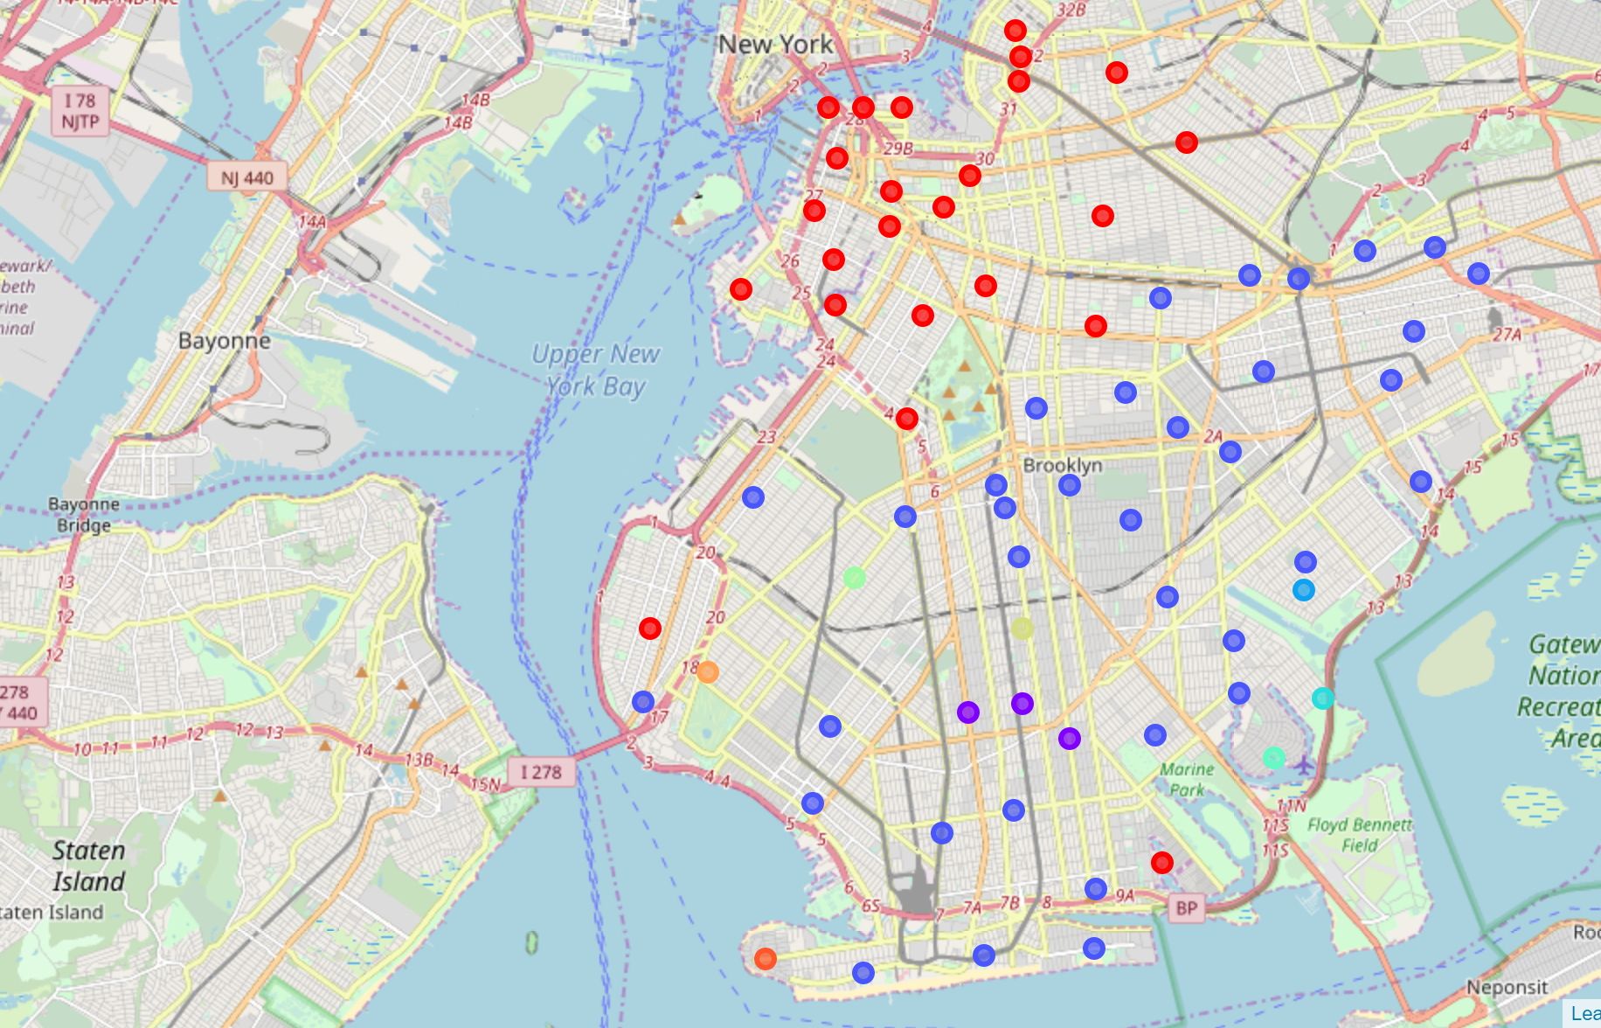
Neighborhoods Map in 10 Clusters
by Type of Venues >>>
Clustering shows our Target Neighborhoods are in cluster 0 shown in Red.
As map shows, most of the neighborhoods belonging to this cluster are located in northeastern parts of Brooklyn that is in close proximity to Manhattan and seem to be influenced from its accessibility.

Slide 6
Results: Following neighborhoods are in cluster 0 and should be the new targets for the Real Estate team.
Bay Ridge
Greenpoint
Crown Heights
Windsor Terrace
Prospect Heights
Williamsburg
Bushwick
Bedford
Stuyvesant
Brooklyn Heights
Cobble Hill
Carroll Gardens
Red Hook
Gowanus
Park Slope
Gerritsen Beach
Clinton Hill
Boerum Hill
East Williamsburg
North Side
South Side
Fulton Ferry
Vinegar Hill

